Slide 1
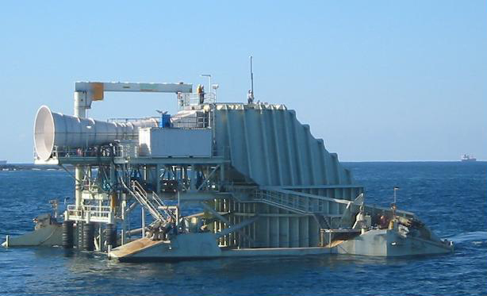
Oscillating Water Column
http://allmarine.blogspot.com/2010/01/oscillating-water-column-for-indonesia.html
By: Nicole Johnson & Eric Olson
CEE 514
12/15/2010
Notes:
Indonesia

Slide 2
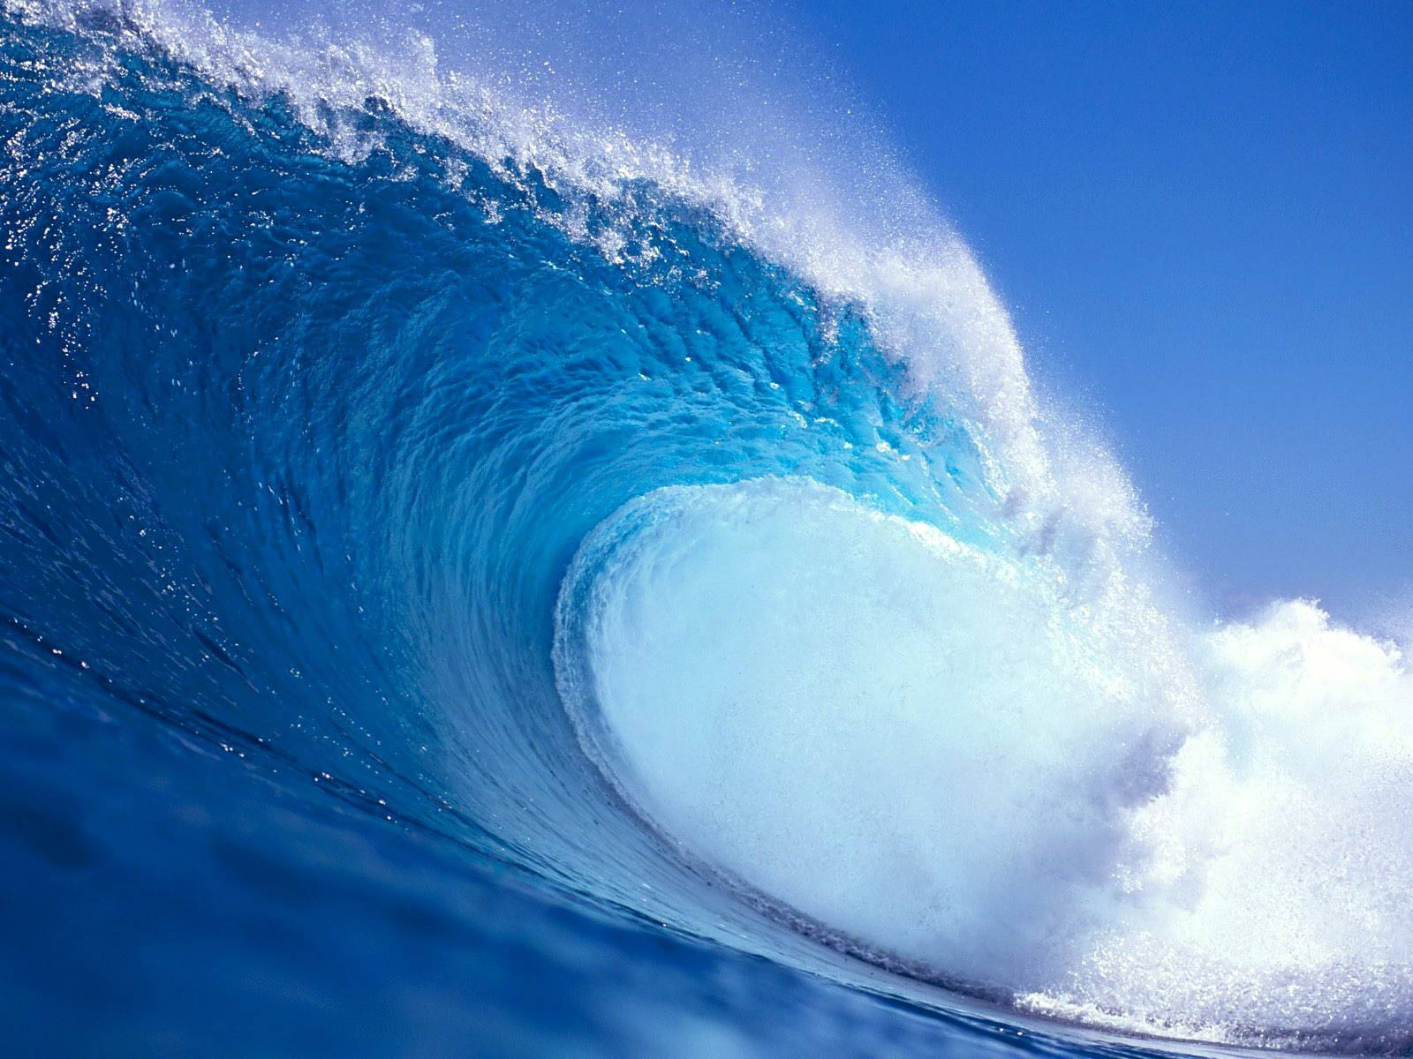
Project Goals
Describe the Oscillating Water Column and how it is used to create power.
Demonstrate how OWC works.
Use OWC phenomena to estimate unknown wave properties.
http://t0.gstatic.com/images?q=tbn:ANd9GcStBhT-PPOwR8gO898nt5mjQpnsDgy-TPNkia96rx-xVLl39bkS0g

Slide 3
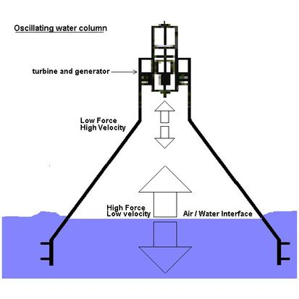
What is an Oscillating Water Column (OWC)
An Oscillating Water Column is a device that converts wave energy into a moving air stream.
Consists of a partially sealed chamber partially submerged beneath the water’s surface.
http://t0.gstatic.com/images?q=tbn:ANd9GcTkuVqokWVoDWnBrdyaUc7r69H8FOJEeFOLd1zoMC248aekWLC_Q
Notes:
Nearshore vs. offshore

Slide 4
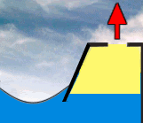
How Does an OWC Work?
Wave motion induces pressure changes beneath the column.
Pressure changes in turn cause the water level in the camber to oscillate.
Oscillating water level causes airflow in the chamber.
http://t2.gstatic.com/images?q=tbn:ANd9GcRiJ9G_oaMn5ujfNnUdz0vlflGjBXmlTa0z_FLYyRLHH0-NbmmA

Slide 5
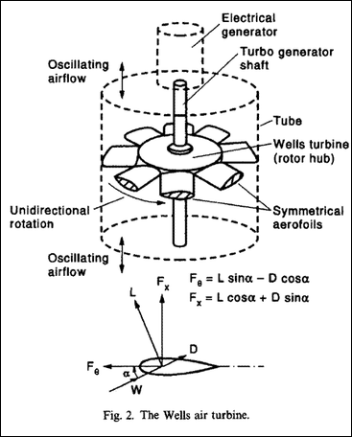
How does an OCW Generate Power?
Moving air caused by pressure differences can be used to rotate a turbine.
Wells Turbine – Rotates in the same direction regardless of the direction of the airstream.
http://t1.gstatic.com/images?q=tbn:ANd9GcSxR_1ZIK0nwBynm6PCLoWSrk-h83zgmvzJMeKKqXRLQpn9y6pA

Slide 6
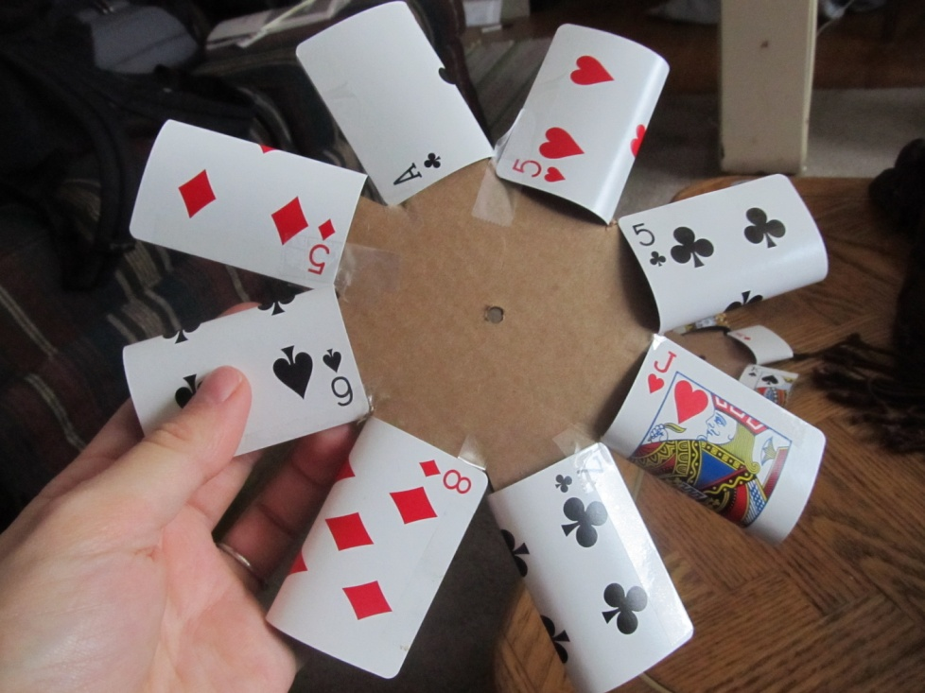
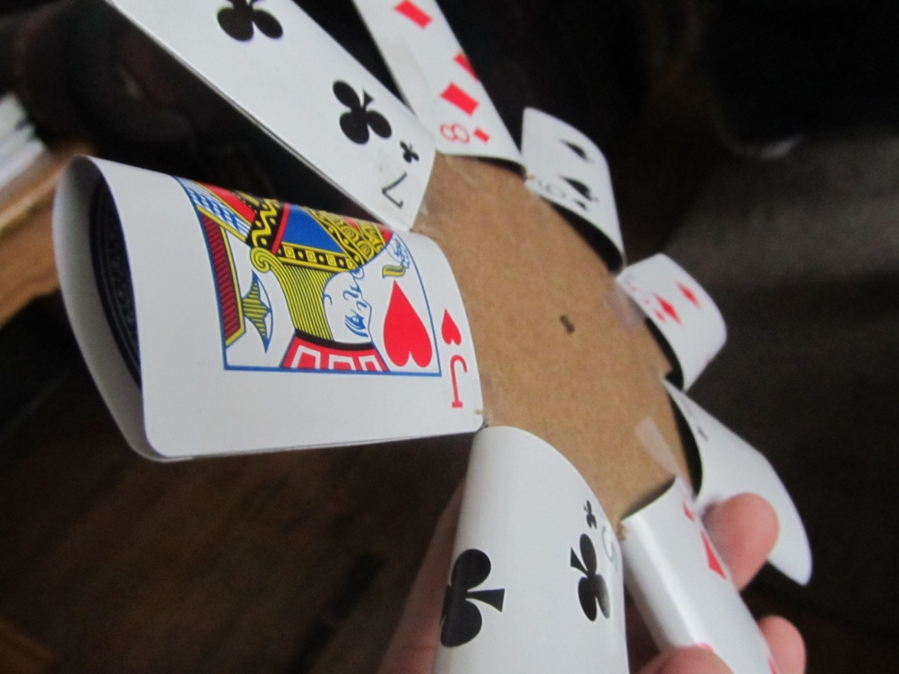
Wells Turbine Demonstration
Materials Used: Cardboard, Straw, Playing Cards, Scotch Tape, Floss.

Slide 7
Wells Turbine Demonstration
Video

Slide 8
Advantages and Disadvantages of OWC and Wave Power
OWC
  Moving parts housed outside of water.
  Can be built near shore for easy access to power grid.
Wave Power
  Advantages:
    Low maintenance
    No greenhouse gases
  Disadvantages:
    Initial Building cost
    Eye sore
Notes:
Do more! Disadvantages??

Slide 9
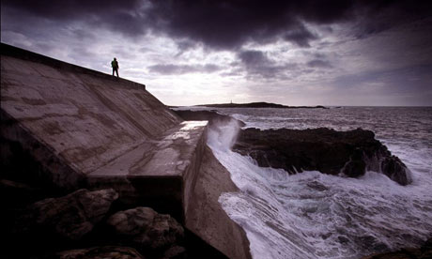
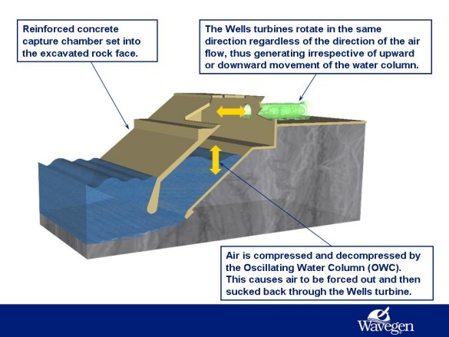
Islay Wavegen OWC Plant
Islay, Scottland
Installed in 2000
500kW rated

Slide 10
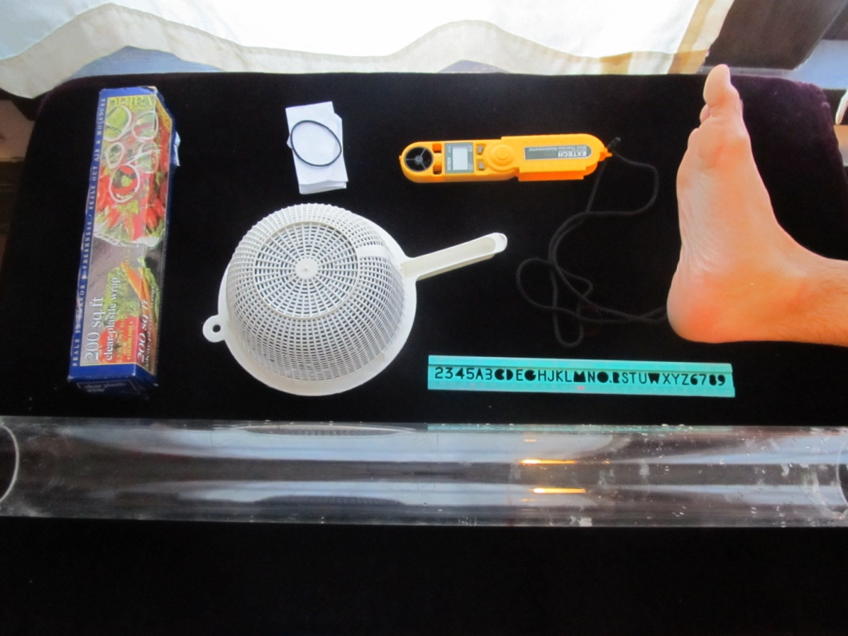
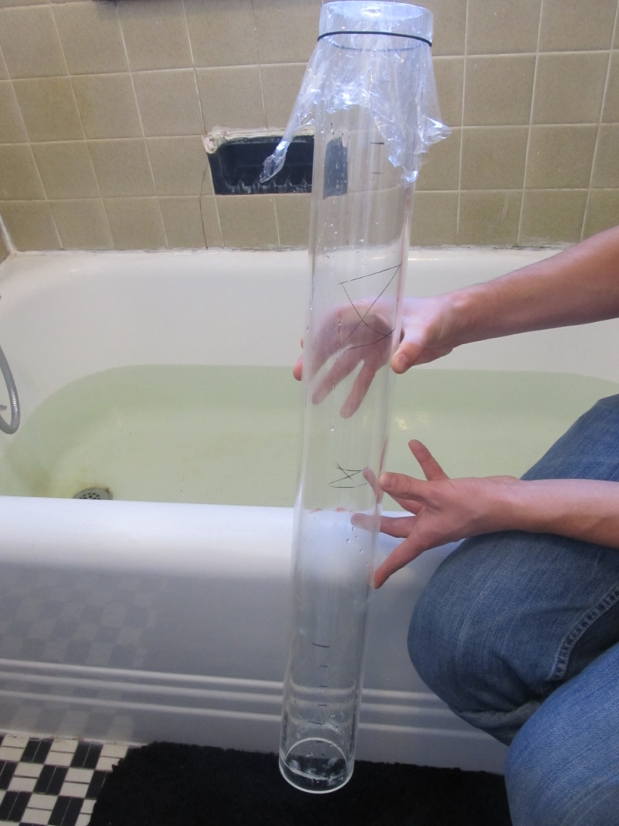
Demonstration
Goal: Demonstrate the Oscillating Water Column Phenomena
Materials Used: Clear PVC Tube, Saran Wrap, Hair Tie, Bathtub, Strainer, Foot.

Slide 11
Demonstration
Video

Slide 12
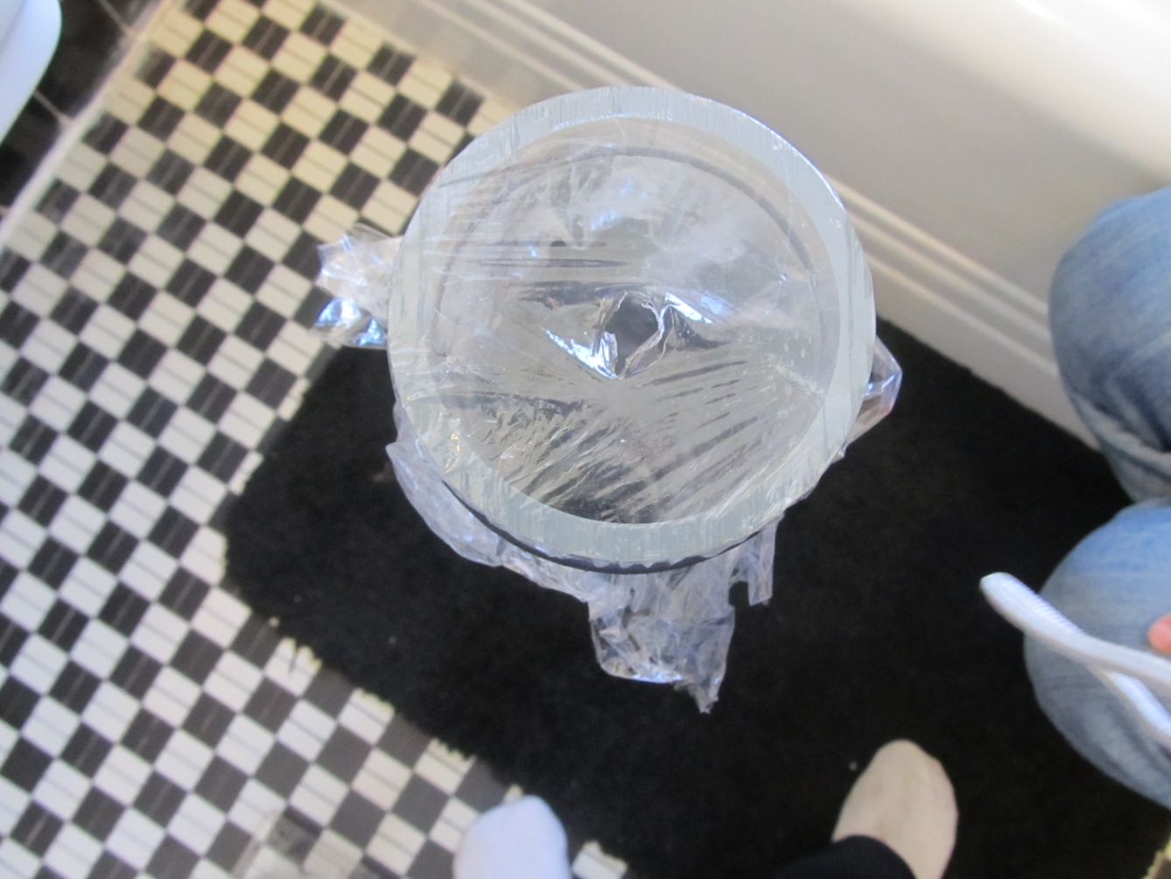
Using OWC to Estimate Wave Height
Materials Used: Original Rig, Ruler, Anemometer.

Slide 13
Using OWC to Estimate Wave Height
Video

Slide 14
Using OWC to Estimate Wave Height
Wave Pressure: P(z)=-ρgz + ρgK_{p}η
Assume Shallow Water => K_{p} = 1
Assume: Max U occurs at τ/2
Therefore: ΔP = ρgH, ΔV=H * A_{0,} Δt= τ/2
Q=H*A₀/(τ/2)
Q= A₁*U
H= A₁*U* (τ/2)/A₀
Notes:
E

Slide 15
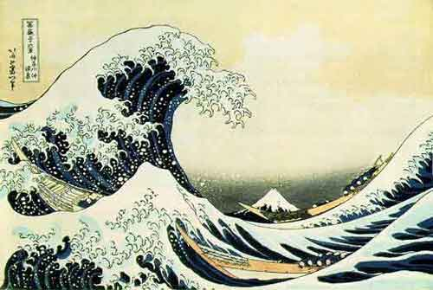
Results
Measured:
  A₀= 45.6 cm. sq.
  A₁=1.27 cm. sq.
  τ = 2 sec.
  U= 20 cm/s
  H=2.54 cm
Calculated:
  H= A₁*U* (τ/2)/A₀
  H=0.55 cm
http://oceanworld.tamu.edu/students/waves/index.html
Notes:
E

Slide 16
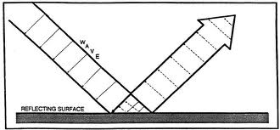
Discussion
Possible Sources of Error
  Shallow Water Assumption
  Strainer Blocking Flow
  Oscillating Air Flow Interference
  Wave Reflection Interference
  Measurement Error
  Uneven wave generation

Slide 17
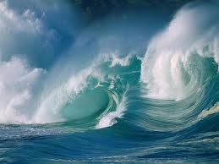
Conclusion
Oscillating Water Column is an excellent method for converting wave energy to usable power.
Using OWC to indirectly measure wave height should only be considered if interfering variables can be kept to a minimum.

Slide 18
References
de O. Flacao, A.F. Control of an Oscillating- Water-Column Wave Power Plant for Maximum Energy Production. 5/3/2002
Evans, D.V. & Porter, R. Hydrodynamic Characteristics of an Oscillating Water Column Device. 3/20/1995
Raghunathan, S. The Wells Air Turbine for Wave Energy Conversion. 1/17/1995
Wu, Chin. Wave Properties. Lecture Slides - CEE 514. 11/15/2010
http://www.wavegen.co.uk/what_we_offer_limpe t.htm. 12/15/2010

Slide 19
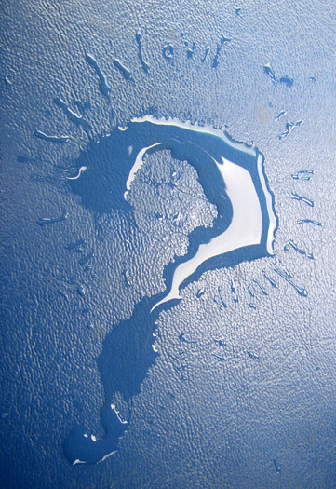
Questions?

